Slide 1
Team Doldit
presents

Slide 2

DolditMan

Slide 3

Arcade game for the running man
The point of the game is to avoid obstacles with jumping.

Slide 4

Game controls
The game is easy for use, the only controls is:
Left Arrow – move left
Right Arrow – move right
Up Arrow – jump

Slide 5
Structure of the game
We have several classes in game:
-for moving ground
-for characters
- for all other stuff (score, player name, moving background, etc.)

Slide 6
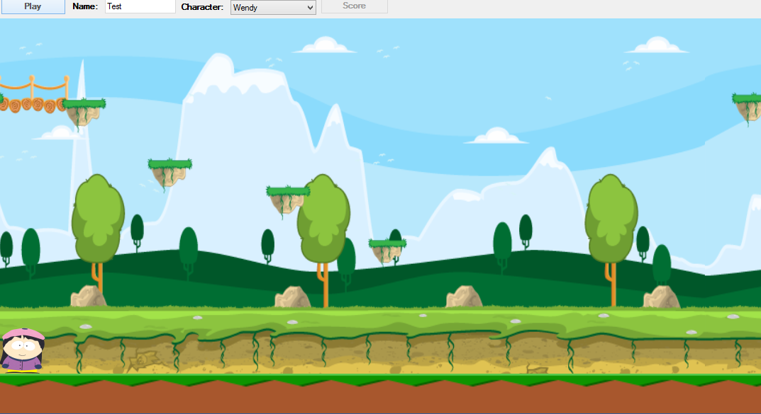
Game view

Slide 7



Team members
Georgi Matsov
https://github.com/bewolf
Martin Papazov https://github.com/MartinPapazov
https://github.com/KirilKazakov
https://github.com/ZdravkoGeorgiev
https://github.com/iliyan88

